Slide 1

PYTHON FILE HANDLING

Slide 2
FILE HANDLING
File handling is basically process of performing operations such as reading, writing, updating any file.
Two Types:
Binary type
Text type

Slide 3
OPENING A FILE IN PYTHON
We use open method to open any file in python
SYNTAX:
open(filename, mode)
filename : name of our indented file we want to open.
Mode : the kind of operation we want to perform on our file.

Slide 4
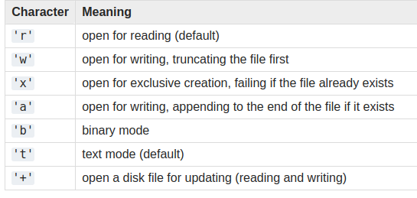
DIFFERENT MODES:

Slide 5
FILE METHODS
read( ) method:
read method basically reads the whole file as a single string.
readline( ) method:
one line at a time
readlines( ) method:
read the whole file as list of string with each string representing a
line.

Slide 6
FILE METHODS
write( s ) method:
writing string “s” to file.
close( ) method
closes the file.

